Slide 1
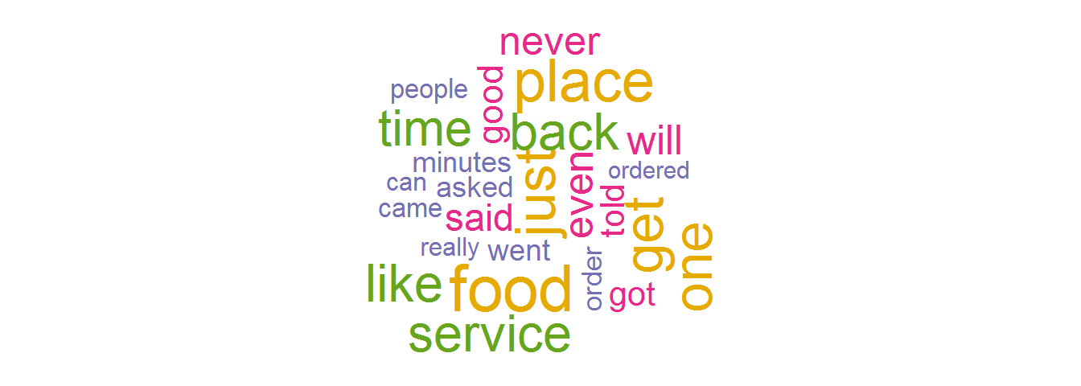
Yelp Reviews
An Analysis of Frequent Words used In Good and Bad Reviews
Swathi Priya N

Slide 2
Introduction
Finding frequent words in positive and Negative Reviews
How business can address the issue based on the words
How can I Extract the data ?

Slide 3
Rating Reviews
There does not seem to be much difference in the words used for star ratings 1-3, possibly due to the small size of the word clouds.
This could also imply that the reviews for star ratings 1-3 are mostly similar.
There is a high number of positive words used in star ratings 4-5, e.g. “love” and “amazing”.
This implies that it may be possible to differentiate between reviews with high (4-5) and low (1-3) star ratings based on the common words used in the reviews.

Slide 4
Good
Reviews
Awesome , Loved , Delicious
Review rating
Bad
Reviews
Bad, worst, uncooked
Review rating

Slide 5
APPROACH
Bar plot of number of reviews for each star rating
Select first 1000 items in each of the good and bad review text Series
Combine all the good and bad review text into a single string
Generate a word cloud of good review words
to_file method for word cloud to save the above image to send to marketing
Filter the 'text' column using the 'stars' column to create Series of good and bad review text
Generate a word cloud of Bad review words

Slide 6
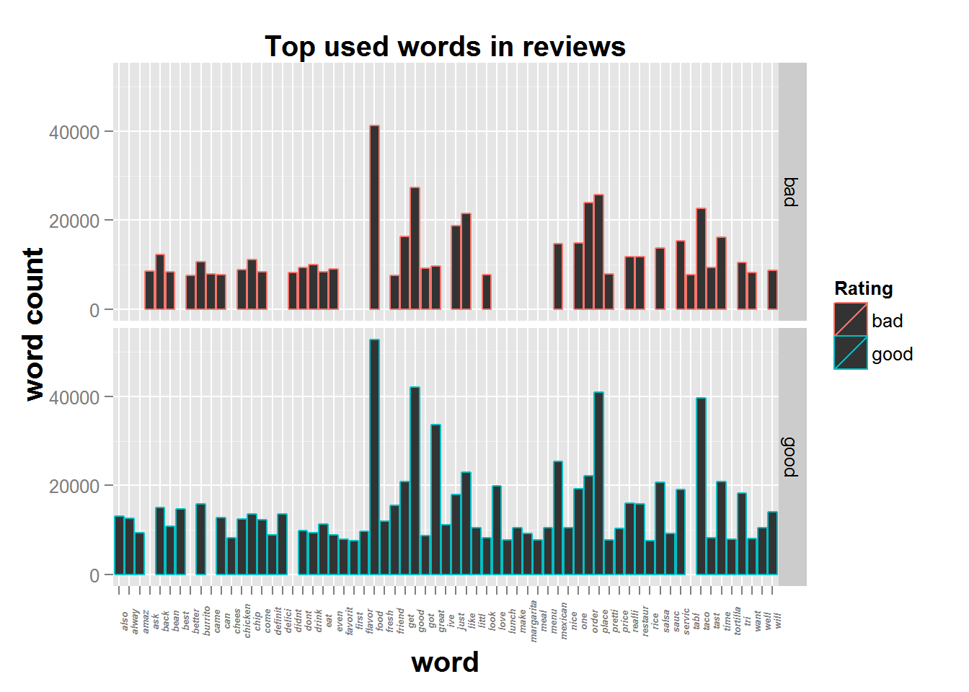
Sample Representation

